Slide 1
Coursera Capstone Project The Battle of Neighborhoods (Week 2)

Slide 2
The report content:
- A description of the problem and a discussion of the background - A description of the problem and a discussion of the background - Download and Explore Dataset - Data will be gather from Foursquare Explore a Given Venue (Apartments) Explore a Given Venue (Shop & Service) Explore a Given Venue (Restaurant) Explore a Given Venue (Medical Center) Explore a Given Venue (School) Explore a Given Venue (Road) - 45 venues categories - Result and conclusion

Slide 3
Part 1 : A description of the problem and a discussion of the background.
The problem is my husband and myself want to move to Dallas and rent an appartment close to his work, the question is where we should go? we care about: The life style, The safeity, The traffic in the area, The appartment need to be 2 bedrooms and 2 bathrooms, price of rent not more that $2,000
.00 a month, Having venues such as coffee shops, restaurants and mall near by. So we are going to look for the nighboor hood in dallas near to Down Town Dallas and compair.(manily we looking for Uptoun, Dallas)
This problem could be applicable to anyone want to move to Dallas for example and having similar cratiera, and we care, because we need an answer to that question, and this problem could be helpful to anyone want to learn how toanswer similar question and parctise a data science real life problem.

Slide 4
Part 2 :A description of the data and how it will be used to solve the problem.
The required data are: The neighborhoods of Down Town Dallas with their geodata (latitud and longitud) (manily we will compair between Irving and Richirdson) The of apartments for rent in Uptown area (price, life style, shopping) The Venues in UpTown
how the data will be used to solve the problem:
From Foursquare find top 10 venues for Dallas neighborhoods and clustered in groups From Foursquare find location of rental places,with price detials. From Foursquare find the venues. and compare between Irving and Richirdson.

Slide 6
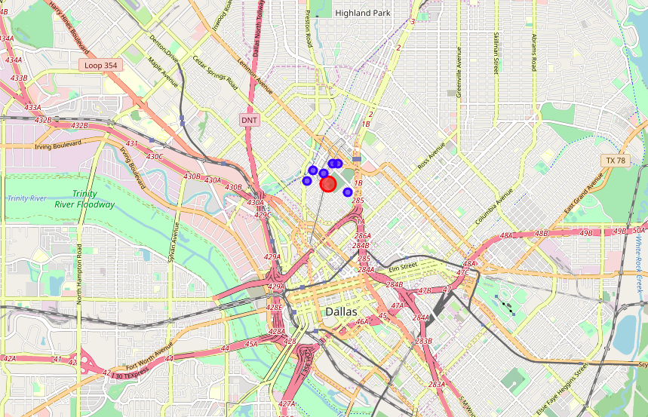

Slide 7
Explore a Given Venue (Apartments)
Get the venue's overall rating of Monaco on the Trail Apartments:
This venue has not been rated yet.
Get the venue's overall rating of Hosting.com Corporate Apartments:
This venue has not been rated yet.
Get the venue’s :overall rating of Manchester State Thomas Apartments:
This venue has not been rated yet

Slide 8
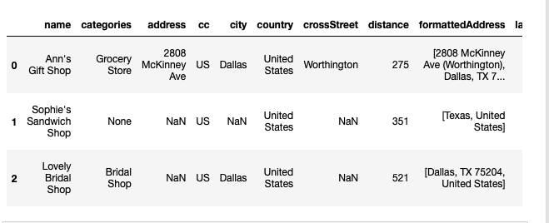
Explore a Given Venue (Shop & Service)

Slide 9
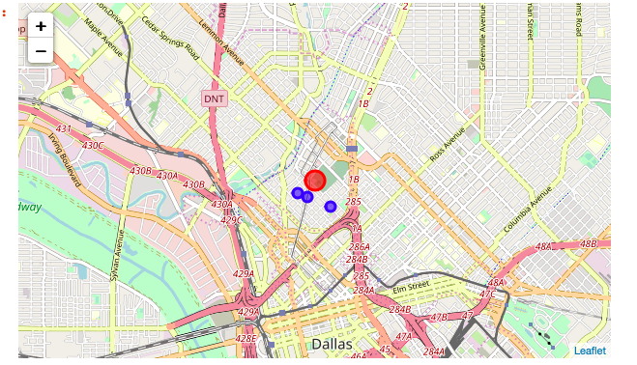

Slide 10
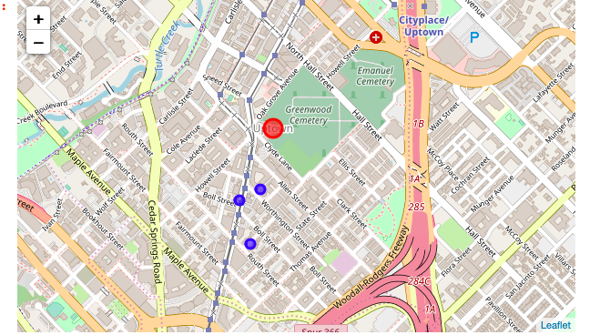

Slide 11
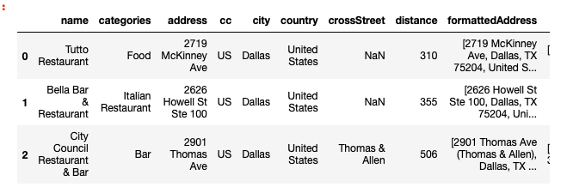
Explore a Given Venue (Restaurant)

Slide 12
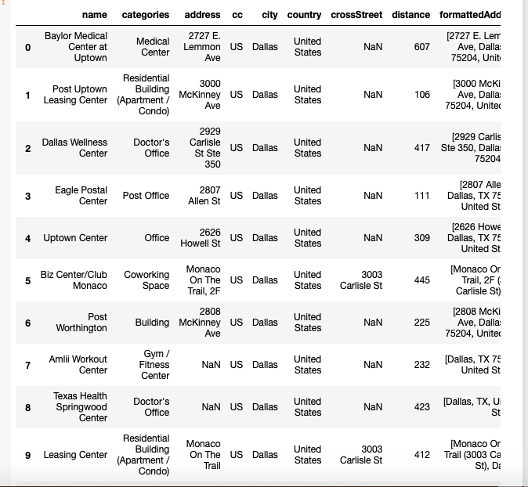
Explore a Given Venue (Medical Center)

Slide 13
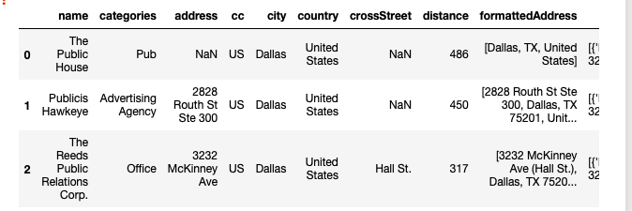
Explore a Given Venue (School)

Slide 14
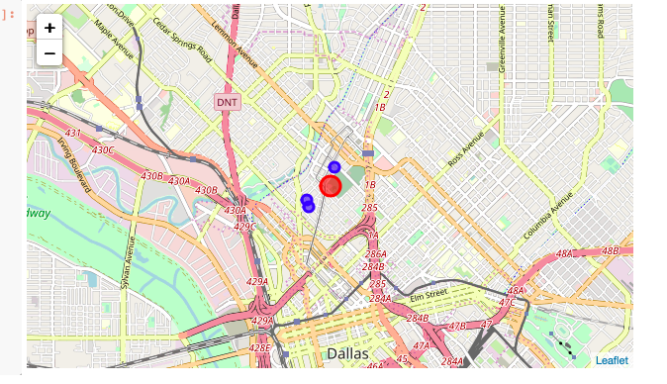

Slide 15
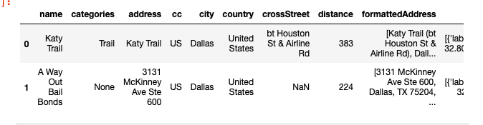
Explore a Given Venue (Road)

Slide 16
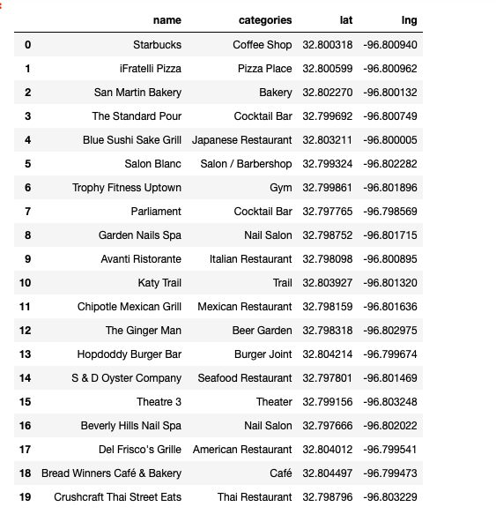
All venues Categories

Slide 17
Result and conclusion
From we explore Uptown Dallas if palce has many attraction and close facilities to almost everything but we could not see and rate for the list of apartment. The good thing is the Katy Trail was close to all the apartments.
Any was very good experiance of using Foursquare and learn how to find detial about the palce.

